Slide 1
working principle of midi interface
Md. Fazle Rabbi
ID:16CSE057

Slide 2

Musical Instrument Digital Interface

Slide 3
MIDI Basics
First introduced in 1983
MIDI isn’t hardware or software
It’s a universal “digital language” and means of communication for music technology

Slide 4
MIDI Basics
MIDI consists of performance information—like print music

Slide 5
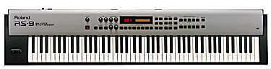
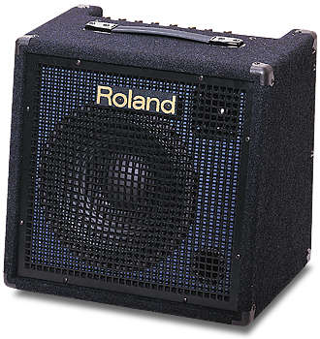
MIDI Basics
MIDI is completely independent of the audio circuitry—it’s not sound.
Note On; Note Number; Velocity; Note Off
IN OUT THRU
MIDI
L R AUDIO

Slide 6
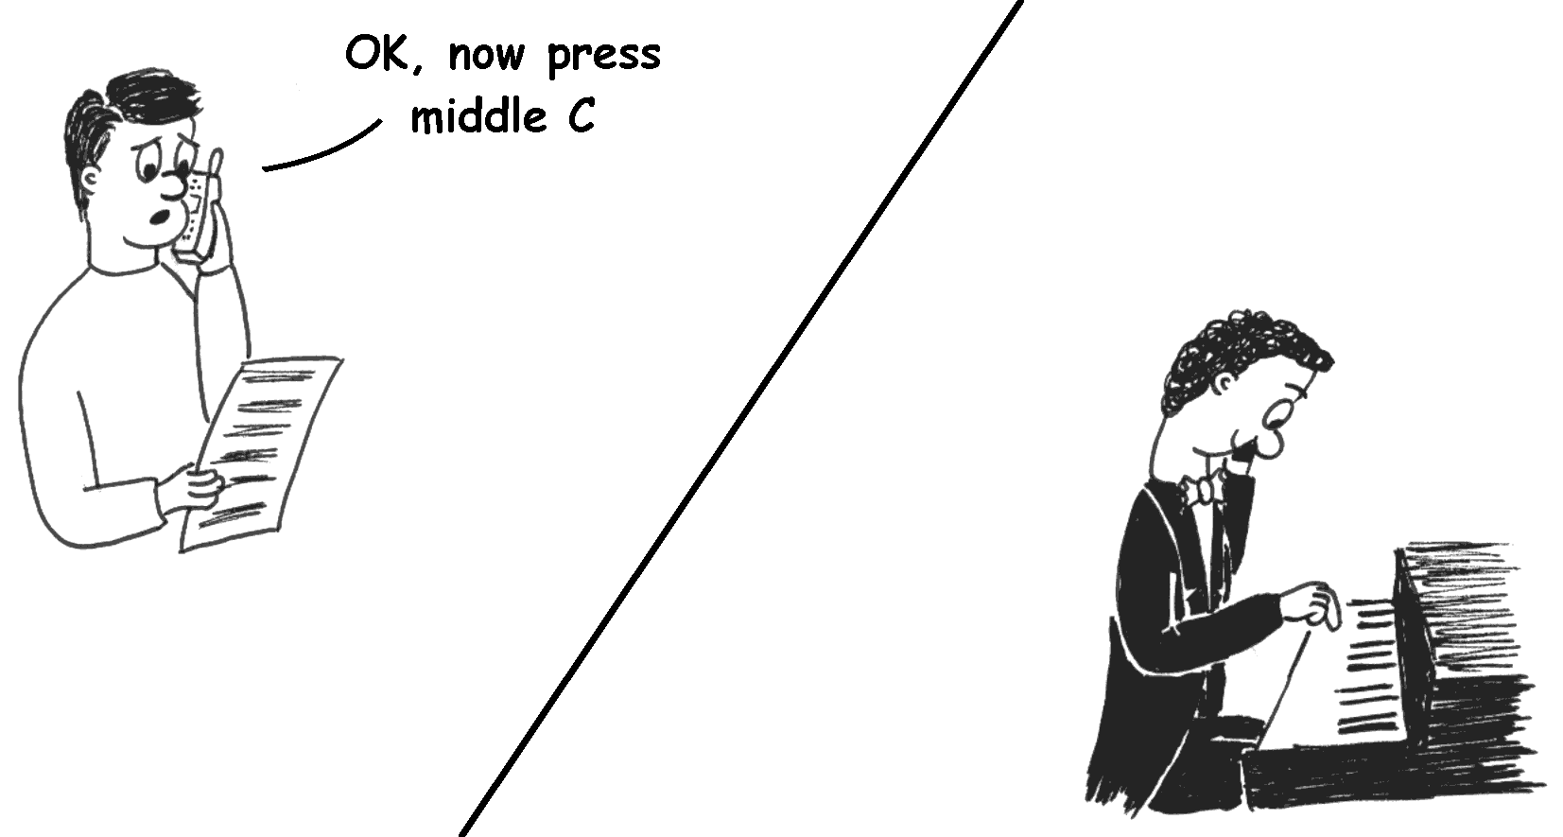
MIDI
MIDI doesn’t transmit digital audio.
What it does transmit is the basic information supplied by the performer:
What keys are pressed/released, and when
What pedals are pressed etc.

Slide 7
MIDI devices communicate using messages…
m e s s a g e s
Note on
Note off
Program change
Pitch bend
Controller change
Pressure (polyphonic)
Pressure (monophonic)
Notes:
7

Slide 8
MIDI Specification – The Techie Bit
Physically MIDI is:
A simplex asynchronous serial interface
Simplex – data only flows in one direction, from transmitter to receiver
Serial – bits of data are transmitted one at a time in series (rather than all at once in parallel)
Asynchronous – the duration of each bit is fixed (32 µs for MIDI). Both the transmitter and receiver need a separate accurate clock to measure this duration. No clock signal is transmitted so only a single pair of wires is needed.
Baud rate = 31250 bits/second
Data is transmitted in 8-bit packets with one start bit, one stop bit and no parity.

Slide 9
Digital Serial Communications
Start bit (always 0)
Stop bit (always 1)
Data bits
1
0
time
LSB
MSB
320 μs
Eg. To transmit (105)₁₀ = (01101001)₂
Start
bit
Stop
bit
1
0
0
1
0
1
1
0
48 µs
32 µs
32 µs
32 µs
32 µs
32 µs
32 µs
32 µs
Start bit detected
1
0
0
1
0
1
1
0

Slide 10
MIDI Connections
Most MIDI devices have three sockets:
MIDI In: Receives MIDI information
MIDI Out: Transmits MIDI information
MIDI Thru: Repeats exactly the ‘MIDI In’ signal
Using the ‘Thru’ socket, more than one instrument can be controlled by a single MIDI output:
IN
OUT
THRU
IN
OUT
THRU
IN
OUT
THRU
A
B
C

Slide 11
MIDI Connections
MIDI Ports
IN OUT THRU
To next
MIDI IN
IN – Receives MIDI information
OUT – Transmits MIDI information
THRU – Passes along MIDI information

Slide 12
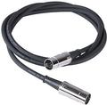
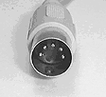
MIDI Connections
MIDI Cable
A cable with a 5-pin DIN connector on each end.

Slide 13
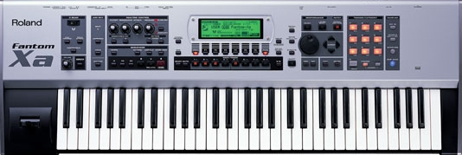
MIDI Connections
MIDI “Master” instrument
The instrument that sends information
MIDI “Slave” instrument
The instrument that receives information
IN OUT THRU
IN OUT THRU
Slave
Master

Slide 14

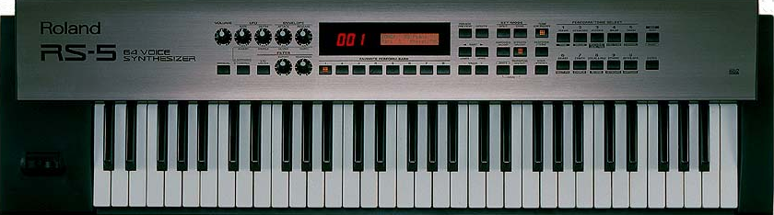
Computers & MIDI
Connecting a MIDI Interface
IN OUT

Slide 15
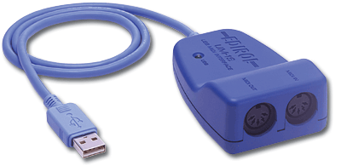
Computers & MIDI
MIDI Interface
A device that is used to connect a computer to a MIDI system
Provides the MIDI IN and OUT ports for connection to a MIDI device
Translates MIDI data into a computer’s own machine language

Slide 16
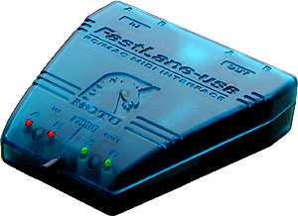
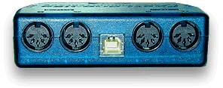
Multi-port MIDI Interface (2 in/out pairs)
OUT
A B
IN
A B
Lights!
USB port
Thru switch – connects In to Out,
for use without a computer
Leave in ‘out’ position!
Notes:
16

Slide 17

Multi-port MIDI Interface (8 in/out pairs)
Front
MIDI Outputs
MIDI Inputs
Back
Each MIDI cable can carry 16 channels.
USB port
Notes:
17

Slide 18
MIDI Messages
All that the physical MIDI interface does is allow the transmission and reception of 8-bit numbers
To play music, a language or protocol is needed to make sense of the numbers
MIDI uses messages consisting of one or more bytes
Most messages use 2 or 3 bytes in this format:
Status Byte
Data Byte 1
Data Byte 2
1
Message Type
Channel No.
0
Data 1 (0-127)
0
Data 2 (0-127)

Slide 19
Status Bytes and MIDI Channels
Status Byte
Data Byte 1
Data Byte 2
1
Message Type
Channel No.
0
Data 1 (0-127)
0
Data 2 (0-127)
All MIDI messages begin with a status byte
The most significant bit of a status byte is always ‘1’, for any other byte, it is ‘0’
Bits 4,5 and 6 of the status byte indicate the message type (giving eight possible messages)
The lowest 4 bits hold the channel number
MIDI devices can be set to only respond to a particular channel number, allowing up to 16 instruments to be independently controlled from a single MIDI output

Slide 20
Message Types
Message bits
Message Type
Data Byte 1
Data Byte 2
000
Note Off
Note Number
Velocity
001
Note On
Note Number
Velocity
010
Polyphonic Aftertouch
Note Number
Pressure
011
Control Change
Controller Number
Value
100
Program Change
Program Number
(not used)
101
Channel Aftertouch
Pressure
(not used)
110
Pitch Bend
LSByte
MSByte
111
System Message
Data
Data

Slide 21
Note On/Off
Status Byte
Data Byte 1
Data Byte 2
1
0
0
0/1
Channel No.
0
Note Number (0-127)
0
Velocity (0-127)
Off/On
C#2
49
D#2
51
F#2
54
G#2
56
A#3
58
C#3
61
D#3
63
F#3
66
G#3
68
A#4
70
C2
48
D2
50
E2
52
F2
53
G2
55
A3
57
B3
59
C3
60
D3
62
E3
64
F3
65
G3
67
A4
69
B4
71
When a key is pressed, a note-on message is transmitted
When a key is released, a note-off message is transmitted

Slide 22

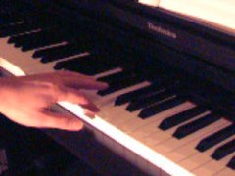
Example
Action
MIDI message
MIDI Output
No key pressed
Nothing
Idle
10010000, 01000001, 01100100
(144, 65, 100)
F3 pressed
Note On, F3, Velocity=100
F3 Held
Nothing
Idle
10000000, 01000001, 00110111
(128, 65, 55)
F3 released
Note Off, F3, Velocity=55

Slide 23
Control Change
Status Byte
Data Byte 1
Data Byte 2
1
0
1
1
Channel No.
0
Controller Number (0-127)
0
Value (0-127)
Other than the keyboard, several other controls affect the sound e.g. the volume knob, sustain pedal, modulation wheel etc.
When any of these controls are adjusted, the new value is transmitted using a control change message.
Controller number identifies the control to be altered (e.g. 1 = modulation, 7 = volume)
The value can be either:
A number between 0 and 127 for continuous controllers
Either 0 or 127 indicating ‘off’ and ‘on’ for switches

Slide 24
THE END

